Slide 1

FAIRSHARE
Transparent Expenses, Hassle-Free Settlements
SPRINT 1
KHUSHI SHAH

Slide 2
BACKLOG MANAGEMENT - PRIORITY STORIES
SPRINT 1
Story | Points | Role | Benefit | Value
User Signup & Login | 5 | User | Access to a private dashboard. | Security & Privacy: Ensures user financial data is protected.
Create Group | 3 | Group Admin | Organizes shared costs by categories. | Scalability: Allows users to manage multiple social circles simultaneously.
Join Group via Invite Code | 3 | Invited Member | Join a group in seconds via code. | User Acquisition: Reduces friction for new users to start using the app.
Add Expense | 8 | Admin/Member | Digitally logs a transaction. | Data Integrity: Creates a "source of truth" for all group spending.
Edit/Delete expense | 5 | Admin/Member | Fixes typos or removes errors. | System Trust: Users feel confident that accidental mistakes won't ruin the math.
Equal Expense Split | 5 | Members | Auto-calculates individual shares. | Efficiency: Saves time and eliminates "calculator fatigue" during settlements.
Basic Balance Dashboard | 8 | Admin/Member | Sees "Net Balance" (Who owes whom). | Financial Transparency: Prevents disputes by showing clear, data-backed debt status.

Slide 3
SPRINT 1 -
KEY METRICS
Planned Velocity: 37 points
Actual Velocity: 37 points
Sprint Predictability Rate: 100%
Sprint Addition Rate: 0%
Sprint Completion Rate: 100%

Slide 4
Epic | Story | Task Decomposition
Expense Management | Receipt Attachments | •Implement file upload component in React •Create Cloud/Local storage service for files • Link File-ID to Expense Entity in DB
Smart Split Options | Custom Percentage Split | • Develop percentage-based calculation engine • Add "Percentage" input mode to UI • Validate that total percentages sum to 100%
Smart Split Options | Selective Participant Split | • Build participant selection toggle/checkboxes • Update "Split Logic" to filter out non-selected users • Recalculate balances based on active subset
SPRINT 2 -
TASKS PER STORY
01
SPLIT AMAONG SELECTED MEMBERS
02
PERCENTAGE SPLIT
03
ATTACH RECEIPT TO EXPENSE

Slide 5
STORY 1 - Custom Percentage Split
Priority: High | Estimate: 8 Story Points
User Story
"As a Member, I want to split an expense by custom percentages, so that participants can pay amounts proportional to their specific share rather than just an equal division."
Acceptance Criteria
Variable Input: The UI provides an input field for each participant to enter a specific percentage.
Sum Validation: The system must prevent submission if the total sum of percentages is not exactly 100%.
Real-time Calculation: The system must display the equivalent dollar amount as the user types the percentage.
Precision: Calculated amounts must round to two decimal places (financial accuracy
STORY 2 - Selective Participant Split
Priority: Medium | Estimate: 8 Story Points
User Story
"As a User, I want to choose which members share a particular expense, so that only the people who actually participated in the cost are responsible for the debt."
Acceptance Criteria
Selection UI: The "Add Expense" form includes a checklist of all group members.
Default State: By default, all members are selected (Equal Split), but users can "uncheck" specific people.
Exclusion Logic: Unchecked members must have a $0.00$ balance recorded for that transaction.
Dashboard Update: The dashboard must reflect that only the selected members' net balances were impacted.
STORY 3 - Receipt Management
Priority: Medium | Estimate: 5 Story Points
User Story
"As a Member, I want to attach a receipt to an expense, so that I have digital proof of the transaction for group reference and verification."
Acceptance Criteria
File Support: Users can upload common image formats (JPG, PNG) or PDFs during the expense creation flow.
Association: Each uploaded file must be uniquely linked to its corresponding Expense ID in the database.
Visibility: Attached receipts must be accessible and viewable by all members within that specific group.
Validation: The system must enforce a 5MB file size limit to maintain optimal performance.
SPRINT 2 - USER STORIES, ESTIMATES AND ACCEPTANCE CRITERIA

Slide 6
SPRINT 3 -
STORIES
02
FINAL SETTLEMENT & BALANCE RESET
PRIORITY - HIGH
User Story:
As a Member, I want to clear all debts after payment, so that my balance sheet reflects zero owed and we can begin a new expense cycle.
01
AUTOMATED DEBT SIMPLIFICATION
PRIORITY - HIGH
User Story:
As a Member, I want the system to automatically generate settlement instructions, so that debts are cleared with the minimum number of transactions possible.
03
EXPORT FULL BALANCE SHEET
PRIORITY - MEDIUM
User Story:
As a Member, I want to export the full balance sheet, so that I can have a permanent record of all transactions and final settlements for my personal files.

Slide 7
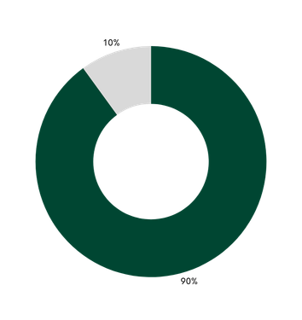
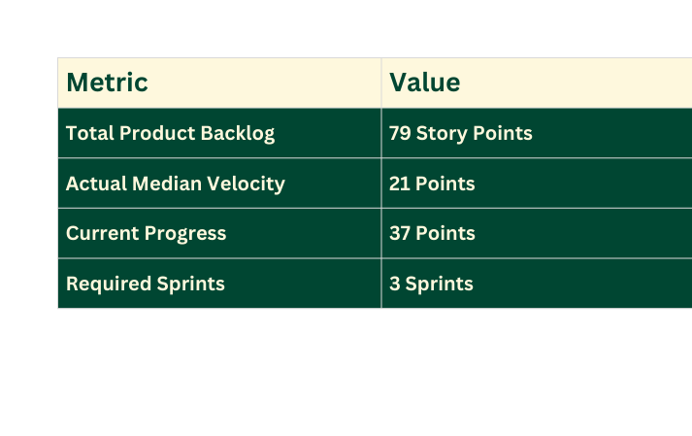
ESTIMATED SPRINTS FOR FULL DELIVERY
SPRINT 1
37 points
SPRINT 2
21 points
SPRINT 3
21 points
90% CONFIDENCE INTERVAL (CI) ANALYSIS
3 SPRINTS REQUIRED IN TOTAL
Projected Completion: Based on our actual median velocity, the project is scheduled for completion at the end of Sprint 3.
Confidence Rating: 90%.
Analysis: While our median is 21, our "Sprint 1 Burst" of 37 points provided a significant head start. This allows us to handle the complex "Settlement Engine" in Sprint 3 even if our velocity remains at the median level of 21.
The "Win": By the end of Sprint 2, we will have 58 points done (37 + 21), leaving only 21 points for the final sprint. It fits perfectly into a 3-sprint plan.

Slide 8
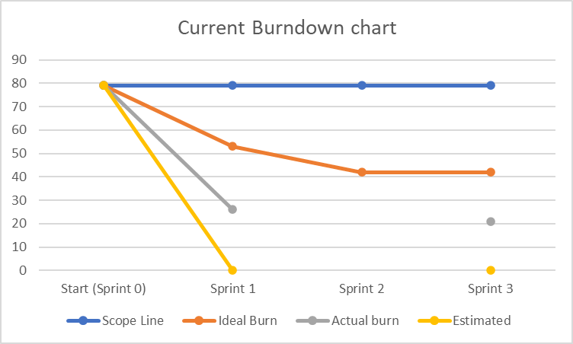
CURRENT
BURNDOWN
CHART
The gray line represents the actual burn from Sprint 1.
We reduced the remaining work from 79 to 26 story points, which reflects strong progress in our first sprint.
The yellow line represents our estimated projected burn based on planned velocity for upcoming sprints.

Slide 9
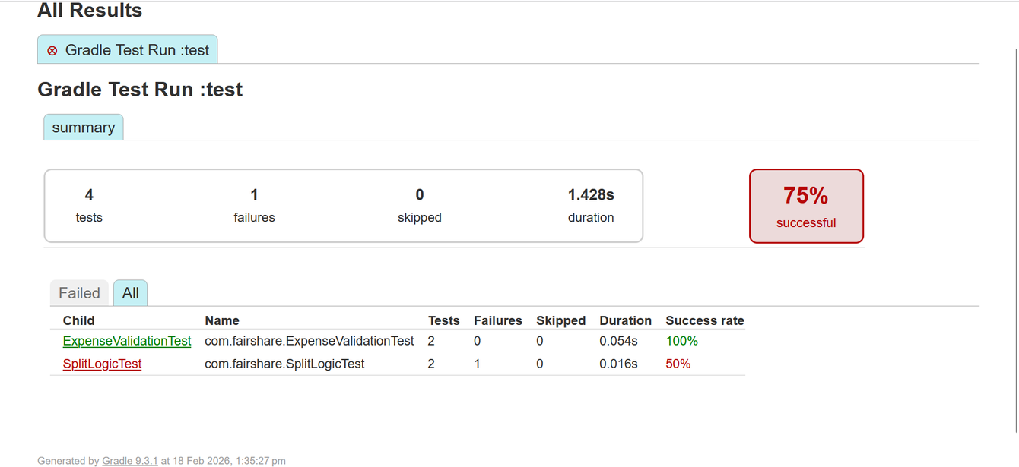
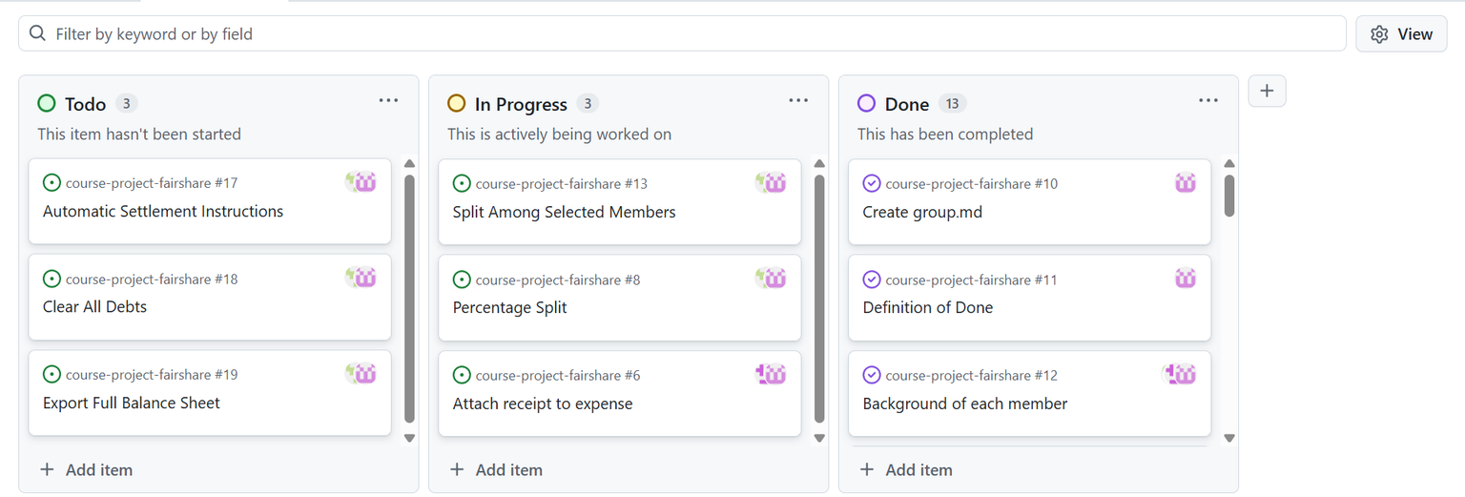
GRADLE
BUILD
Shows all the succcessful and failed builds
PLANNING BOARD

Slide 10
RETROSPECTIVE
START
STOP
CONTINUE
Start writing clearer acceptance criteria for stories like Add Expense and Equal Split.
Start breaking 8-point stories (like Basic Balance Dashboard) into smaller stories earlier.
Start updating the burndown chart daily instead of end-of-week.
Start peer code reviews before merging PRs.
Start estimating tasks (not just stories) during sprint planning.
Stop taking large stories into sprint without proper decomposition.
Stop working on tasks without moving them on the board.
Stop waiting until the last 2 days to test features.
Stop unclear communication about role-based permissions (Admin vs Member).
Stop assuming backend API is ready without confirmation.
Continue good collaboration between frontend and backend.
Continue daily standups — they helped unblock issues quickly.
Continue focusing on user value (Login → Add Expense → Dashboard flow).
Continue realistic story point estimation (5–8 range was manageable).

Slide 11
Video Link: https://youtu.be/nV-iAE6gtnw
THANK YOU
FOR YOUR
COOPERATION

